Slide 1

Data Cleaning Project
smartwatch_health_data

Slide 2
Introduction:
Data cleaning is a critical step in data analysis. It is the process of detecting, correcting, or removing errors, inconsistencies, and inaccuracies in the data to improve its quality.

Slide 3
What is Data Cleaning?
Data cleaning is the process of identifying and correcting or removing errors, inconsistencies, and inaccuracies in the data. Data cleaning ensures that the data is accurate, complete, and reliable. Data cleaning involves different techniques, such as detecting outliers, removing duplicates, handling missing values, and transforming the data.

Slide 4
Why is Data Cleaning Important?
Data cleaning is important for several reasons. Firstly, it ensures that the data is accurate and reliable, which is essential for making informed decisions. Secondly, data cleaning helps to improve data quality, making it more usable for data analysis. Thirdly, data cleaning can help to reduce data processing time and costs by eliminating unnecessary data.

Slide 5
How to Clean Data?
There are different techniques for cleaning data, depending on the dataset and the type of data. Some of the common techniques for data cleaning include:
Detecting and handling missing values
Removing duplicates
Handling outliers
Transforming data
Standardizing data
Normalizing data
Handling data inconsistencies
Removing irrelevant data

Slide 6
Datasets for Data Cleaning! smartwatch_health_data
CONTENT :
This data set contains smartwatch health information likes User ID, Heart Rate (BPM), Blood Oxygen Level (%), Step Count, Sleep Duration (hours),Activity level, Stress Level.
1.Reading Data Set :

Slide 7
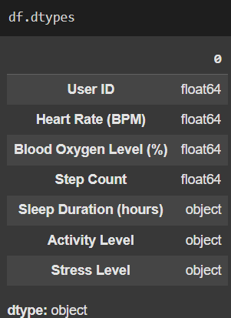
2.Checking Data Types

Slide 8
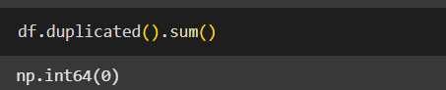
3.Finding Duplicates

Slide 9
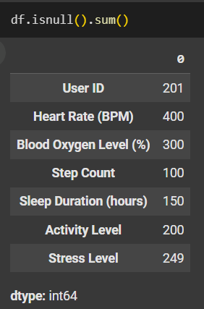
4.Finding Null values

Slide 10
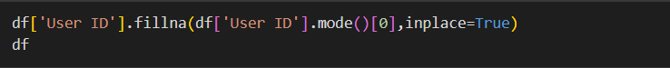
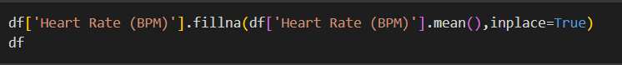
6.Filling Nan values
1.Filling User ID column using mode()
2.Filling Heart Rate (BPM) column using mean()
3.Filling Blood Oxygen Level (%) column using mean()

Slide 11
6.Filling Nan values
4.Filling Step Count column using mean()
5.Filling Sleep Duration (hours) column using mean()
6.Filling Activity Level column using mode()

Slide 12
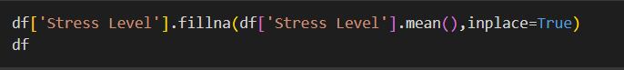
6.Filling Nan values
4.Filling Stress Level column using mean()

Slide 13
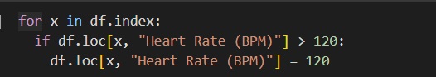
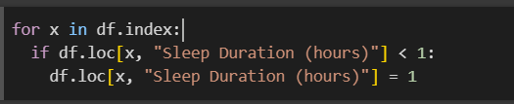
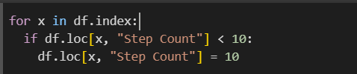
6.FiXing WRONG values
4.Fixing Heart Rate (BPM) column using logic
4.Fixing Sleep Duration (hours) column using logic
4.Fixing Step Count column using logic

Slide 14
Cleaning Techniques Applied:
Imputed missing values using mean, mode, or custom logic.
Converted invalid bag weight entries ("Unknown") into NaN and filled with appropriate values.
Correcting the wrong values with appropriate values.

Slide 15
Cleaning Techniques Applied:
Imputed missing values using mean, mode, or custom logic.
Converted invalid bag weight entries ("Unknown") into NaN and filled with appropriate values.
Correcting the wrong values with appropriate values.

Slide 16
Conclusion:
Data cleaning is a crucial step in data analysis that ensures data accuracy and reliability. This cleaning process ensures the dataset is now reliable and suitable for further analysis, visualization, and modelling tasks.

